Slide 1
Chapter 7
Spa and hot spring development and management in the hospitality and tourism industry
Dr. Bendegul Okumus
Heather Linton Kelly

Slide 2
Learning Outcomes
Explain the Thermal Lake of Hévíz in terms of its offerings and economic impact
Explain the difference between a spa and a hot spring
Discuss key issues when developing spas and hot springs
Highlight the economic impact of spas and hot springs
Discuss determinants of customer satisfaction with spas and hot springs
Discuss the management of spas and hot springs

Slide 3
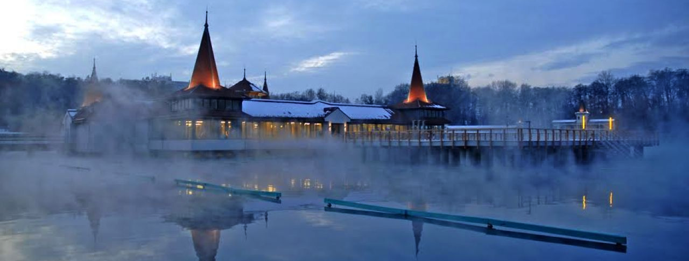
Case Study: Hévíz, Hungary
Click here for a scenic tour of Heviz, Hungary

Slide 4
Spa and Hot Spring Resort Development
A spa can be built essentially anywhere, whereas the location of a hot spring is dependent on the natural phenomena that cause them to occur
Types of spas:
  Resort spa – Located on the property of a hotel, usually as part of a resort that also offers other activities as well. Hotel and spa guests intermingle, and the resort spa is generally an important profit center for the property.
  Amenity spa – Also typically located on the property of a hotel, the amenity spa is treated as an added facility to a hotel, but it is not an important profit center.
  Destination spa – The spa is the main focus of the property, which offers specific health and fitness programs, and additional activities, to guests only.
  Medical spa – Offers a variety of health practices and treatments, and is supervised full-time by a licensed medical professional.

Slide 5
Spa and Hot Spring Resort Development
Other types of spas:
  Club Spa – The primary use is fitness, but it also offers a wide array of professionally-led spa services on a daily basis
  Cruise Ship Spa – A spa center on a cruise ship that offer professional led spa services, fitness services, and wellness components, as well as a spa menu with carefully chosen meals
  Day Spa – A spa center that offer professional spa services on a daily basis. This kind of spa is best developed in western Europe.
  Mineral Springs Spa – A spa that offers natural mineral, thermal, or other springs used for hydrotherapeutic treatments. This kind of spa is the most typical of the European spa/wellness sector.

Slide 6
Spa Benefits to a Resort
Increase RevPAR and ADR
Attract more visitors in the off- and shoulder seasons
Lengthen the shoulder season, thereby shortening the off-season
Be more competitive with other spa resorts
Give business guests a reason to extend their stay
Give leisure guests to book and return to the resort
Position the resort as destination for incentive travel
Enrich spouse/companion programs for business travelers
Provide an indoor activity option during poor weather

Slide 7
Hot Springs (Geothermal/Mineral Springs)
Have been used as healing centers since as far back as 3000 BC on all continents
Hot springs often form near areas of volcanic activity, when water deep below the surface of the Earth is heated by rocks or other means
Mud Pot – Area on the Earth where a hot spring has mixed with dirt or clay on its way to the surface; often a highly acidic, bubbling pool
Paint Pot – A mud pot with minerals that cause the mud to be brightly colored
Extremophile (or Thermophile) – Tiny single-celled organism similar to bacteria that thrives in a hot spring environment

Slide 8
Hot Spring Economic Impact
34,000 thermal/mineral hot springs located around the world
  Over 90 percent are in the Asia-Pacific region (especially Japan & China)
    25,916 locations and economic value of USD $31.60 billion
  Europe is the next most common (especially Germany, Italy & Russia)
    5,967 locations and revenues of USD $21.73 billion
Total economic impact of USD $56.16 billion
Employing approximately 1.8 million people
Projected growth of 4.8% annually by year 2020

Slide 9
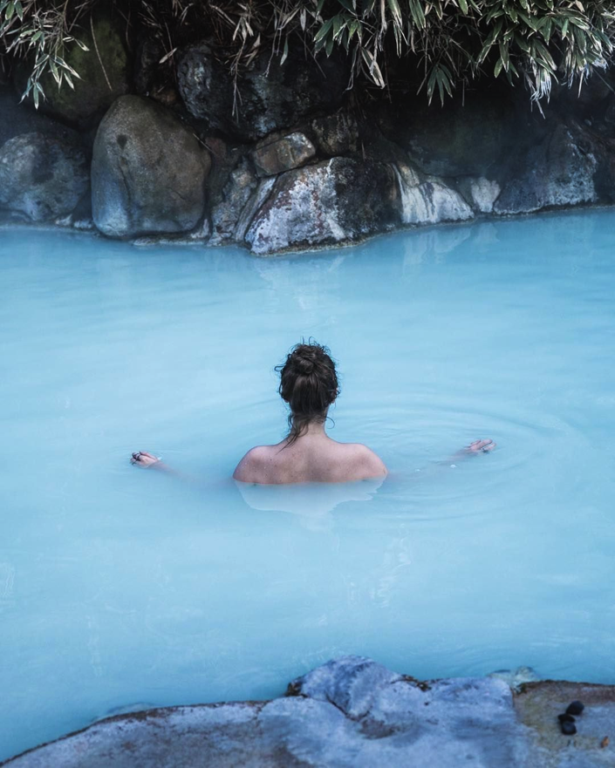
Japanese Onsen
Local public onsen are typically for local residents, and range in cost from free to USD $5 to visit
Day onsen are found in big cities and operate similar to a day spa, with added amenities bringing the average daily cost to USD $15-20
Onsen ryokan, or traditional lodges that are located far from cities and also provide additional facilities, for a higher daily spend

Slide 10
Top 20 Thermal Springs Markets in 2015
China
Japan
Germany
Russia
Italy
Austria
Turkey
Hungary
Spain
Poland
France
Brazil
Czech Republic
United States
Switzerland
Slovenia
Slovakia
Portugal
Iceland
South Korea

Slide 11
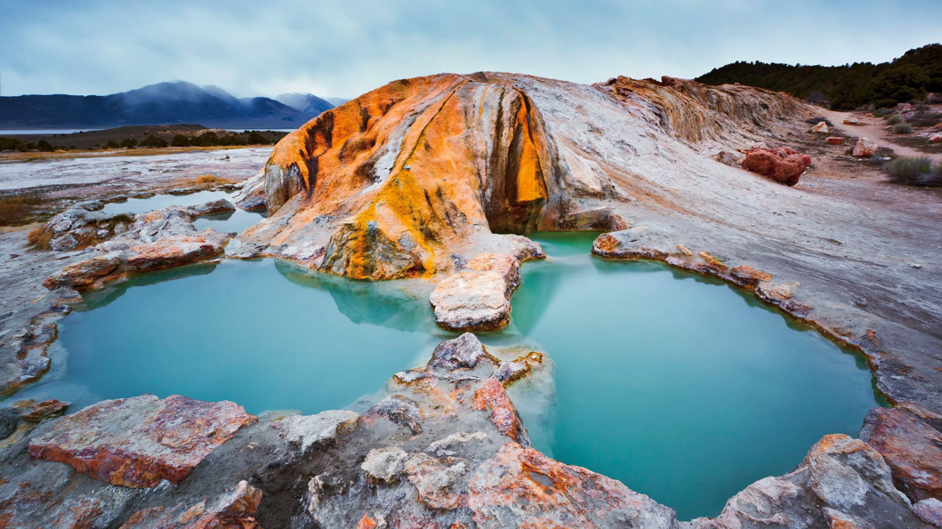
Determinants of Hot Spring Visitor Satisfaction
Environmental quality
  Cleanliness, ecology, cultural features, and recreational activities
Special resources
  Chemical composition, microelements, and mineral concentration and water temperature
Convenience
Food
Service quality
Facilities
Consumption emotion
Perceived value
Targeted consumers

Slide 12
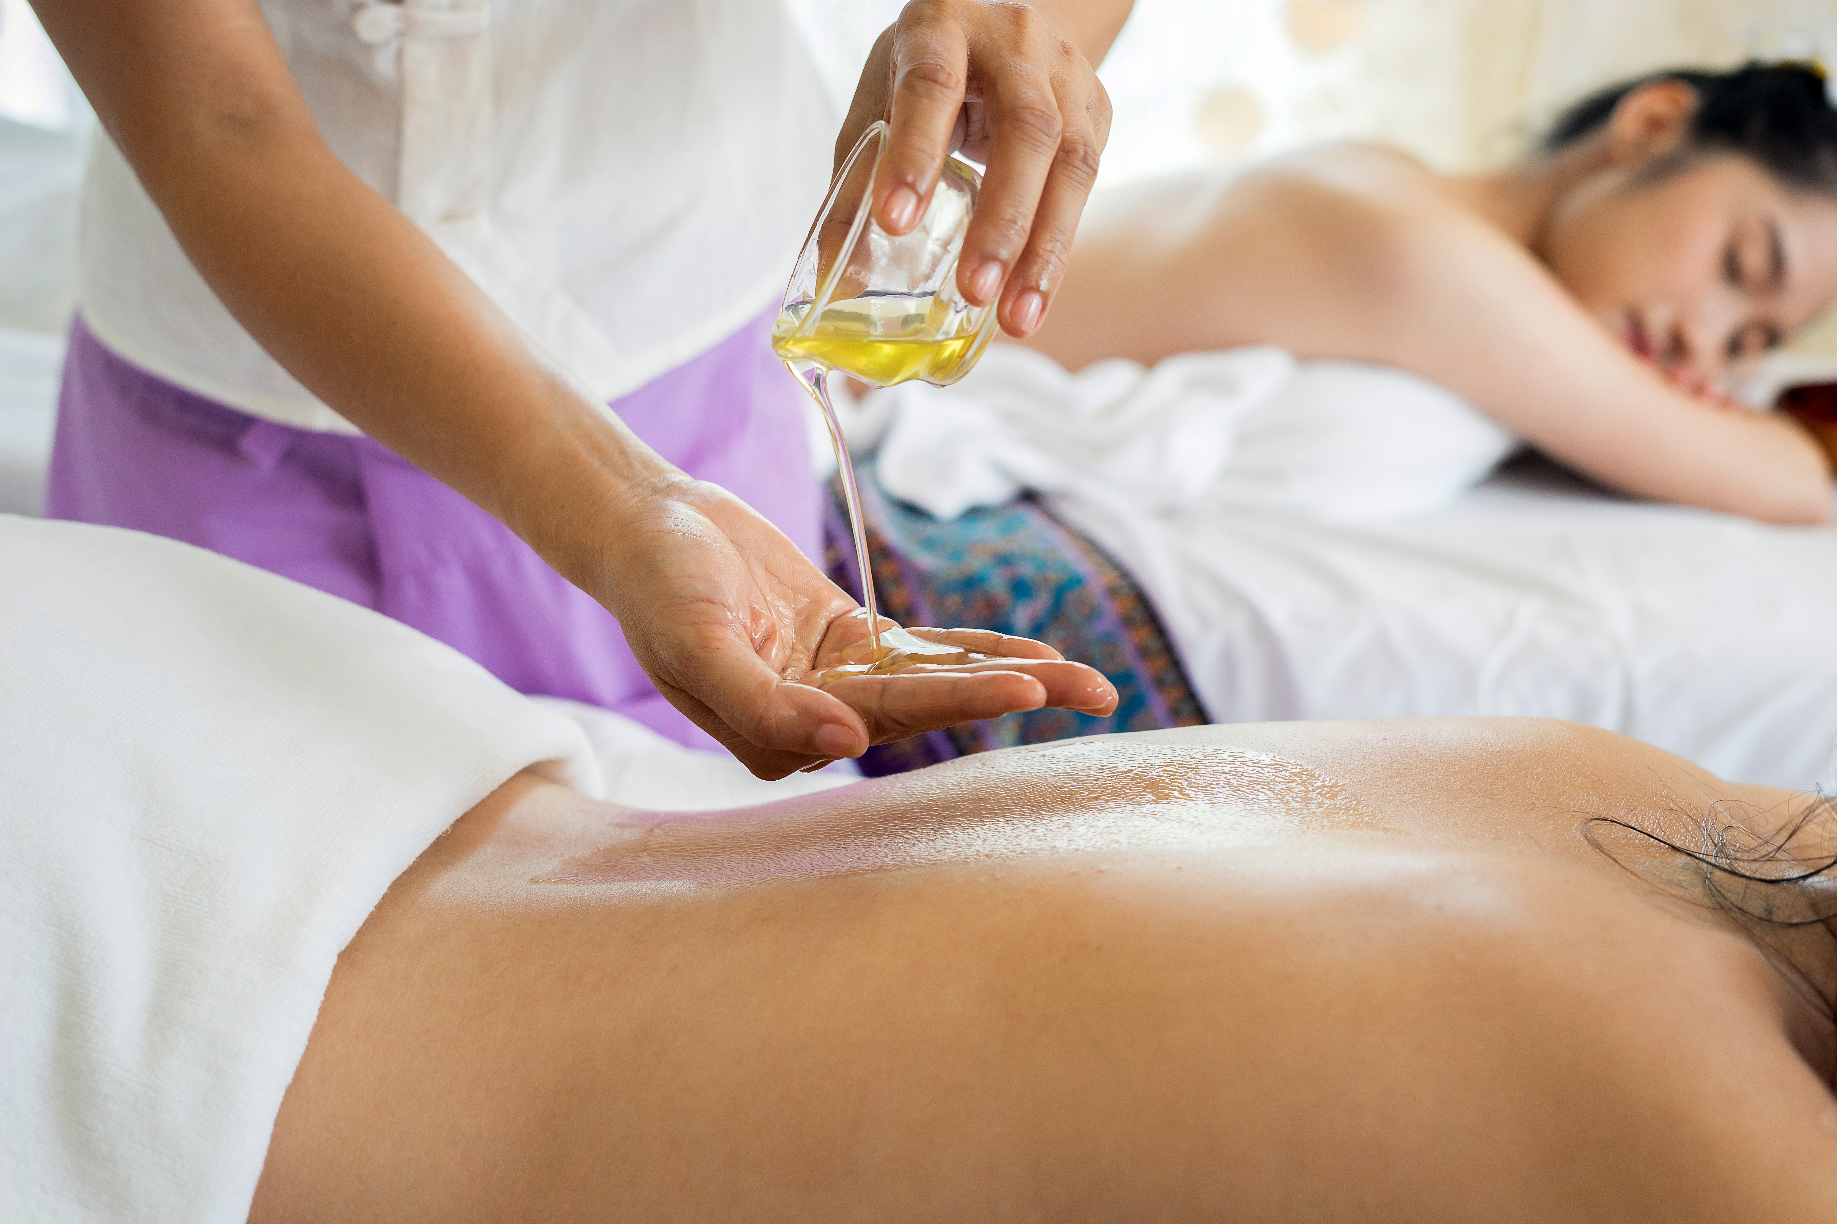
Spa Tourist Satisfaction
Experience Economy – An economy in which many goods and services are sold by emphasizing the effect they can have on people’s live
Servicescape – Physical aspects of a place as well as the amenities provided to a guest
  Can be subjective based on guest perspective

Slide 13
Spa Economic Impact
Asia-Pacific region has the highest number of spa facilities (48,679 facilities, USD $26.5 billion in revenue)
Europe has the highest revenues (46,282 facilities, USD $33.3 billion in revenue)
North America is a close third (30,394 facilities, USD $22.9 billion in revenue)

Slide 14
Management of Spas and Hot Spring Resorts
A turnkey, four-star quality spa can cost over $650 USD per square foot to construct
Key performance indicators (KPIs) that spas can collect and analyze:
  Hotel capture rate (percentage of hotel guests who use spa services)
  Average treatment rate
  Treatment room utilization
  Therapist productivity
  Revenue per available treatment room
  Revenue per guest
  Revenue per square foot
  Revenue per occupied guest room
  Number of services per guest
  Retail sales as a percentage of treatment revenue
  Market segmentation
  Revenue per available treatment hour (RevPATH)
2 ways to calculate RevPATH:
treatment room occupancy
X
average expenditure per person
OR
revenue received in a set time period
÷
number of treatment-hours during that time period

Slide 15
The Nature of Services
Intangible: Cannot be seen, tasted, felt, heard, or smelled before it is purchased, and it does not result in the customer’s ownership of anything
Inseparable from the production process: Typically produced and consumed simultaneously; the client is actually participating in the production process
Variable/Heterogeneous: High human component; resulting end product may differ between providers and may even vary for the same provider on different days
Perishable: They cannot be stored

Slide 16
Summary
Resort spa is located on the property of a hotel, usually as part of a resort that also offers other activities as well. Hotel and spa guests intermingle, and the resort spa is generally an important profit center for the property.
Amenity spa is also typically located on the property of a hotel, the amenity spa is treated as an added facility to a hotel, but it is not an important profit center.
Destination spa’s main focus of the property, which offers specific health and fitness programs, and additional activities, to guests only.
Medical spa offers a variety of health practices and treatments, and is supervised full-time by a licensed medical professional.

Slide 17
Summary
Other types of spas include club spa, cruise ship spa, day spa, and mineral spring spa.
Spas offer several key benefits to hotels
Lead is not typically found in hot spring water and promoted for its benefits.
The majority of naturally occurring hot springs are found in Asia Pacific
An Onsen ID Card provides useful information about that specific hot spring.
Budapest, Hungary is known as the Spa Capital of the World

Slide 18
Summary
Revenue per available treatment hour (RevPATH) is the most useful metric or KPI for a spa manager to know.
Lead is not typically found in hot spring water and promoted for its benefits.
The majority of naturally occurring hot springs are found in Asia Pacific
An Onsen ID Card provides useful information about that specific hot spring.
Budapest, Hungary is known as the Spa Capital of the World
Revenue per available treatment hour (RevPATH) is the most useful metric or KPI for a spa manager to know.

Slide 19
Summary
When hot spring water mixes with dirt and clay on its way to the surface, it is called a mud pot.
Managing spas and hot springs are similar to managing hotels but it also requires special attention to specific aspects of spas and hot springs.
There are key factors influencing customers satisfaction with and loyalty to spas and hot springs.
Spas and hot springs can have important economic impacts on a region/destination

